Slide 1
University physics, classical mechanics, Lecture 8. Still Lesson 7: Rotation of rigid bodies
Teacher: Dr. Paul Briard
Wechat: Paulbg123

Slide 2
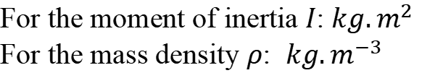
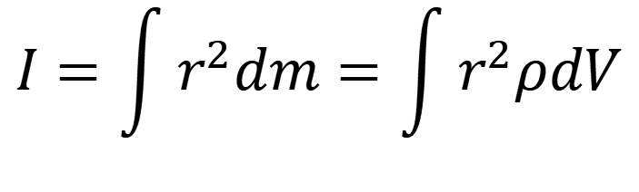
Reminder of the previous lecture
Moment of inertia about an axis
$$I=\int{r^{2}dm}=\int{r^{2}ρdV}$$
body
body
Infinitesimal volume
Distance from the axis
Infinitesimal mass
Local mass density
SI units:
For the moment of inertia $I$: $kg.m^{2}$
For the mass density $ρ$: $kg.m^{−3}$
Notes:
PARLER LENTEMENT: Here I reminds you what we have described last time about the moment of inertia of a rigid body about an axis. It is the integral of the square of the distance from the axis multiplied by the infinitesimal mass dm. We can describe dm as the product between the local mass density rho and the infinitesimal volume dV. The description of this infinitesimal volume depends on the shape of the body. If the mass density in the body is uniform, we can put it outside the integral. If needed, I give you also the SI units. As you can see on the equation, the SI unit of the moment of inertia is kg square meter. You can deduce it from the expression of the moment of inertia. The mass density is the mass per unit volume, thus the SI unit of the mass density is kg per cube meter.

Slide 3


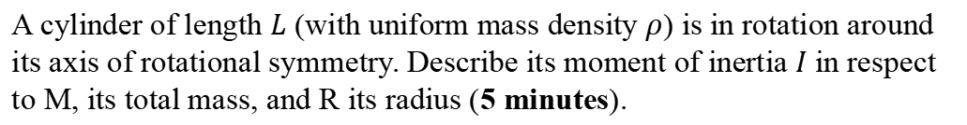
Ex. Moment of inertia of a solid cylinder
$$R$$
$$L$$
A cylinder of length $L$ (with uniform mass density $ρ$) is in rotation around its axis of rotational symmetry. Describe its moment of inertia $I$ in respect to M, its total mass, and R its radius (5 minutes).
Notes:
PARLER LENTEMENT Here is a little exercise to see if you understood how to calculate the moment of inertia. It is the case of a solid cylinder for a rotational motion around its axis of symmetry. The cylinder has length L and Mass M. Its mass density is uniform. It could be a good idea to use what I have said you, but here the shape to consider is a cylinder.

Slide 4



Ex. Moment of inertia of a solid cylinder
As infinitesimal volume, we choose the space between the cylinder of radius r and the cylinder of radius $r+dr$:
$$R$$
$$dV=2πrdrL$$
$$r$$
$$L$$
$$dr$$
Notes:
PARLER LENTEMENT: As infinitesimal volume I choose the space between the cylinder of radius r and the cylinder of radius r+dr.

Slide 5
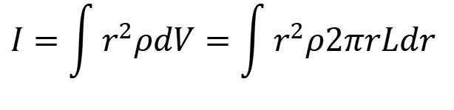
Ex. Moment of inertia of a solid cylinder
As infinitesimal volume, we choose the space between the cylinder of radius r and the cylinder of radius $r+dr$:
$$R$$
$$dV=2πrdrL$$
$$r$$
$$I=\int{r^{2}ρdV}=\int{r^{2}ρ2πrLdr }$$
$$L$$
$$dr$$
Notes:
PARLER LENTEMENT: Then we use the expression of the moment of inertia, you see that here we will have to integrate on the third power of the distance from the axis of the cylinder.

Slide 6
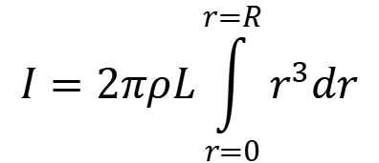
Ex. Moment of inertia of a solid cylinder
As infinitesimal volume, we choose the space between the cylinder of radius r and the cylinder of radius $r+dr$:
$$R$$
$$dV=2πrdrL$$
$$r$$
$$I=\int{r^{2}ρdV}=\int{r^{2}ρ2πrLdr }$$
$$L$$
$$dr$$
$$I=2πρL\int_{r=0}^{r=R}{r^{3}dr}$$
Notes:
PARLER LENTEMENT: We can put outside the integral the mass density because in this exercise the mass density of the cylinder is uniform.

Slide 7
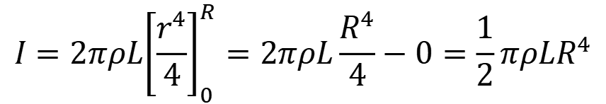
Ex. Moment of inertia of a solid cylinder
As infinitesimal volume, we choose the space between the cylinder of radius r and the cylinder of radius $r+dr$:
$$R$$
$$dV=2πrdrL$$
$$r$$
$$I=\int{r^{2}ρdV}=\int{r^{2}ρ2πrLdr }$$
$$L$$
$$dr$$
$$I=2πρL\int_{r=0}^{r=R}{r^{3}dr}$$
$$I=2πρL{\left[\frac{r^{4}}{4}\right]}_{0}^{R}=2πρL\frac{R^{4}}{4}−0=\frac{1}{2}πρLR^{4}$$
Notes:
PARLER LENTEMENT: Here also I give you all the steps of calculation, but it is not an obligation, of course. We obtain an expression of the moment of inertia, but the exercise ask the moment of inertia in terms of mass of the cylinder and its radius.

Slide 8


Ex. Moment of inertia of a solid cylinder
As infinitesimal volume, we choose the space between the cylinder of radius r and the cylinder of radius $r+dr$:
$$R$$
$$dV=2πrdrL$$
$$r$$
$$I=\int{r^{2}ρdV}=\int{r^{2}ρ2πrLdr }$$
$$L$$
$$dr$$
$$I=2πρL\int_{r=0}^{r=R}{r^{3}dr}$$
$$I=2πρL{\left[\frac{r^{4}}{4}\right]}_{0}^{R}=2πρL\frac{R^{4}}{4}−0=\frac{1}{2}πρLR^{4}$$
$$ρ=\frac{M}{πR^{2}L }$$
$$M=ρV=ρπR^{2}L$$
Notes:
PARLER LENTEMENT: For a uniform mass density rho, the mass of the cylinder is the product between the mass density and its volume. We obtain an expression of the uniform mass density.

Slide 9


Ex. Moment of inertia of a solid cylinder
Ex. Moment of inertia of a solid cylinder
As infinitesimal volume, we choose the space between the cylinder of radius r and the cylinder of radius $r+dr$:
$$R$$
$$dV=2πrdrL$$
$$r$$
$$I=\int{r^{2}ρdV}=\int{r^{2}ρ2πrLdr }$$
$$L$$
$$dr$$
$$I=2πρL\int_{r=0}^{r=R}{r^{3}dr}$$
$$I=2πρL{\left[\frac{r^{4}}{4}\right]}_{0}^{R}=2πρL\frac{R^{4}}{4}−0=\frac{1}{2}πρLR^{4}$$
$$I=\frac{1}{2}MR^{2}$$
$$ρ=\frac{M}{πR^{2}L }$$
$$I=\frac{1}{2}MR^{2}$$
$$M=ρV=ρπR^{2}L$$
Notes:
PARLER LENTEMENT: And finally we obtain the moment of inertia we wished. Take care that for another axis of rotation, you should obtain another expression of the moment of inertia.

Slide 10


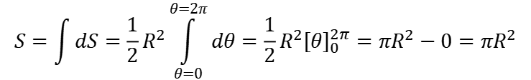

Imagine we want to use integral calculation to describe the surface of a disk
$$dS=\frac{1}{2}Rl=\frac{1}{2}R^{2}dθ$$
$$R$$
$$l=Rdθ$$
$$dθ$$
$$r$$
Disk of surface S=?
$$S=\int{dS}=\frac{1}{2}R^{2}\int_{θ=0}^{θ=2π}{dθ}=\frac{1}{2}R^{2}{\left[θ\right]}_{0}^{2π}=πR^{2}−0=πR^{2}$$
Notes:
PARLER LENTEMENT: Often, there is not only one choice of infinitesimal surface or infinitesimal volume. For the same example of the disk, we consider here as infinitesimal surface as infinitesimal piece of the disk, corresponding to the infinitesimal angle d_theta. We obtain the same expression than previously of the surface of the disk.

Slide 11
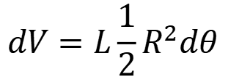
What if we choose an infinitesimal volume such as
$$R$$
$$dV=L\frac{1}{2}R^{2}dθ$$
$$r$$
$$L$$
Notes:
PARLER LENTEMENT: What if we use the previous infinitesimal surface to describe the infinitesimal volume as follows.

Slide 12
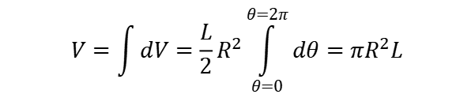
What if we choose an infinitesimal volume such as
$$R$$
$$dV=L\frac{1}{2}R^{2}dθ$$
$$V=\int{dV}=\frac{L}{2}R^{2}\int_{θ=0}^{θ=2π}{dθ}=πR^{2}L$$
$$r$$
$$L$$
No issue to describe the volume of the cylinder. What about its moment of inertia around its axis ?
Notes:
PARLER LENTEMENT: If we want to describe what is the volume of the cylinder, this infinitesimal volume is an appropriate choice, we obtain the expression of the volume of the cylinder. What about its moment of inertia around its axis ?

Slide 13
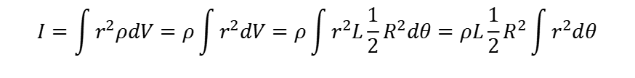
What if we choose an infinitesimal volume such as
$$R$$
$$dV=L\frac{1}{2}R^{2}dθ$$
$$V=\int{dV}=\frac{L}{2}R^{2}\int_{θ=0}^{θ=2π}{dθ}=πR^{2}L$$
$$r$$
$$L$$
No issue to describe the volume of the cylinder. What about its moment of inertia around its axis ?
$$I=\int{r^{2}ρdV}=ρ\int{r^{2}dV}=ρ\int{r^{2}L\frac{1}{2}R^{2}dθ}=ρL\frac{1}{2}R^{2}\int{r^{2}dθ}$$
Issue to describe the Moment of inertia !
Notes:
PARLER LENTEMENT: But if we want to describe the moment of inertia for rotation around its axis you can here that there will be an issue. We cannot describe the moment of inertia,

Slide 14
What if we choose an infinitesimal volume such as
$$R$$
$$dV=L\frac{1}{2}R^{2}dθ$$
$$V=\int{dV}=\frac{L}{2}R^{2}\int_{θ=0}^{θ=2π}{dθ}=πR^{2}L$$
$$r$$
$$L$$
No issue to describe the volume of the cylinder. What about its moment of inertia around its axis ?
$$I=\int{r^{2}ρdV}=ρ\int{r^{2}dV}=ρ\int{r^{2}L\frac{1}{2}R^{2}dθ}=ρL\frac{1}{2}R^{2}\int{r^{2}dθ}$$
Issue to describe the Moment of inertia !
The appropriate choice of infinitesimal volume don’t depends only to the shape of the body you consider but also the problem to solve !
You have to take care here the distance from the axis of rotation appears inside the integral.
Notes:
PARLER LENTEMENT:The appropriate choice of infinitesimal volume don’t depends only to the shape of the body you consider but also the problem to solve !
You have to take care here the distance from the axis of rotation appears inside the integral. The infinitesimal volume should have included the infinitesimal change of radius $dr$ !

Slide 15





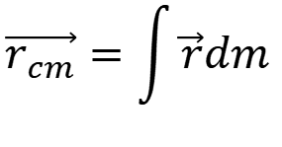
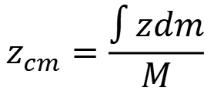
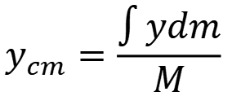
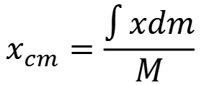
Reminder: The center of mass
The position of the center of mass of a body of mass M is defined as follows:
$$\vec{r_{cm}}=\int{\vec{r}dm}$$
body
$$x_{cm}=\frac{\int{xdm}}{M}$$
$$y_{cm}=\frac{\int{ydm}}{M}$$
$$z_{cm}=\frac{\int{zdm}}{M}$$
$$y$$
body of total mass $M=\int{dm}$
$$y_{cm}$$
$$\vec{r_{cm}}$$
$$O$$
$$x$$
$$z_{cm}$$
Notes:
PARLER LENTEMENT: Here, I just reminds you the description of the position of the center of mass of the rigid body. You can describes by its position vector or by its 3D coordinate x,y,z.

Slide 16


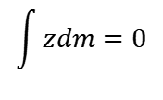
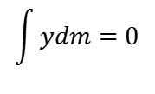
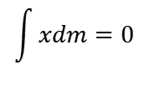

Reminder: The center of mass
The position of the center of mass of a body of mass M is defined as follows:
$$\vec{r_{cm}}=\int{\vec{r}dm}$$
$$x_{cm}=\frac{\int{xdm}}{M}$$
$$y_{cm}=\frac{\int{ydm}}{M}$$
$$z_{cm}=\frac{\int{zdm}}{M}$$
If the center of mass is the origin of the Cartesian coordinate system, then
$$x_{cm}=0$$
$$y_{cm}=0$$
$$z_{cm}=0$$
$$\int{xdm}=0$$
$$\int{ydm}=0$$
$$\int{zdm}=0$$
body
body
body
Notes:
PARLER LENTEMENT: And if the enter of mass is the origin of the 3D coordinate system, we obtain a property about the integral over the mass in the body of each coordinate x, y, z which are equal zero,

Slide 17




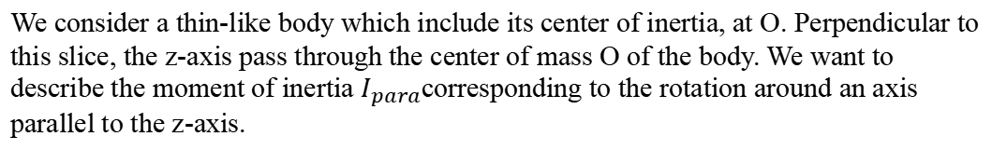
Parallel axis theorem: Introduction
$$y$$
$$dm$$
$$r_{cm}$$
$$⊙$$
$$r_{para}$$
$$O$$
$$⊙$$
$$x$$
$$z$$
We consider a thin-like body which include its center of inertia, at O. Perpendicular to this slice, the z-axis pass through the center of mass O of the body. We want to describe the moment of inertia $I_{para}$corresponding to the rotation around an axis parallel to the z-axis.
Notes:
PARLER LENTEMENT; We have seen that the moment of inertia of a body in rotation around an axis depends on which axis to consider. We consider a thin-like body which include its center of inertia, at O. Perpendicular to this slice, the z-axis pass through the center of mass O of the body. We want to describe the moment of inertia $I_{para}$corresponding to the rotation around an axis parallel to the z-axis. dm is an infinitesimal mass in the body at distance r_cm from the center of mass and at distance r_para from an axis parallel to the axis chosen passing through the center of mass.

Slide 18
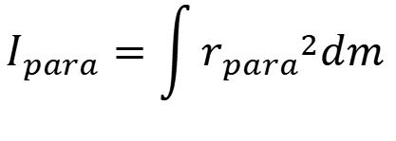
Parallel axis theorem: Introduction
$$y$$
$$dm$$
$$r_{cm}$$
$$⊙$$
$$r_{para}$$
$$O$$
$$⊙$$
$$x$$
$$z$$
We consider a thin-like body which include its center of inertia, at O. Perpendicular to this slice, the z-axis pass through the center of mass O of the body. We want to describe the moment of inertia $I_{para}$corresponding to the rotation around an axis parallel to the z-axis.
$$I_{para}=\int{{r_{para}}^{2}dm}$$
Notes:
PARLER LENTEMENT; The moment of inertia of the body for rotation around this parallel axis is described as follows.

Slide 19

Parallel axis theorem: Introduction
$$y$$
$$dm$$
$$r_{cm}$$
$$⊙$$
$$r_{para}$$
$$O$$
$$⊙$$
$$x$$
$$z$$
We consider a thin-like body which include its center of inertia, at O. Perpendicular to this slice, the z-axis pass through the center of mass O of the body. We want to describe the moment of inertia $I_{para}$corresponding to the rotation around an axis parallel to the z-axis.
$$I_{para}=\int{{r_{para}}^{2}dm}$$
$$I_{cm}=\int{{r_{cm}}^{2}dm}$$
For rotation round z-axis, the moment of inertia is:
Notes:
PARLER LENTEMENT; We have seen that the moment of inertia of a body in rotation around an axis depends on which axis to consider. And the moment of inertia for around the z-axis which pass through the center of mass is described as follows, This two moment of inertia are different because these two axis of rotation are different.

Slide 20
Parallel axis theorem: Introduction
$$y$$
$$dm$$
$$r_{cm}$$
$$⊙$$
$$r_{para}$$
$$O$$
$$⊙$$
$$x$$
$$z$$
We consider a thin-like body which include its center of inertia, at O. Perpendicular to this slice, the z-axis pass through the center of mass O of the body. We want to describe the moment of inertia $I_{para}$corresponding to the rotation around an axis parallel to the z-axis.
$$I_{para}=\int{{r_{para}}^{2}dm}$$
$$I_{cm}=\int{{r_{cm}}^{2}dm}$$
For rotation round z-axis, the moment of inertia is:
$dm$ is on the plane $xOy$, the body is thin-like (this permits to simplify the calculation)
Notes:
PARLER LENTEMENT; To simplify the explanation, we consider the body is thin-like as for a disk for instance. Which means the infinitesimal mass dm is on the plane xOz.

Slide 21
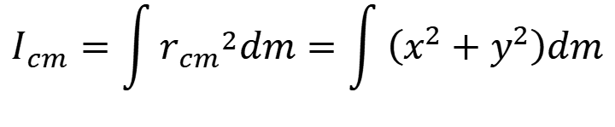
Parallel axis theorem: Introduction
$$y$$
$$dm$$
$$r_{cm}$$
$$⊙$$
$$r_{para}$$
$$b$$
$$O$$
$$⊙$$
$$x$$
$$d$$
$$z$$
$$a$$
$$I_{cm}=\int{{r_{cm}}^{2}dm}=\int{\left(x^{2}+y^{2}\right)dm}$$
Notes:
PARLER LENTEMENT: The center of mass is here the center of the coordinates system. Thus we can describe the moment of inertia for rotation around the z-axis as follows, where x and y and the coordinates of the infinitesimal mass dm.

Slide 22
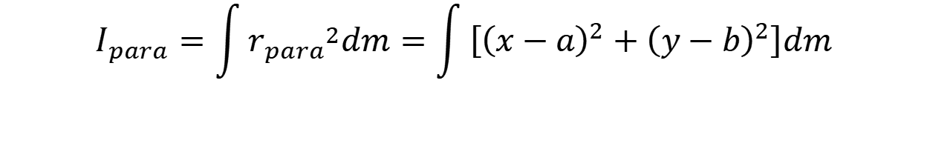
Parallel axis theorem: Introduction
$$y$$
$$dm$$
$$r_{cm}$$
$$⊙$$
$$r_{para}$$
$$b$$
$$O$$
$$⊙$$
$$x$$
$$d$$
$$z$$
$$a$$
$$I_{cm}=\int{{r_{cm}}^{2}dm}=\int{\left(x^{2}+y^{2}\right)dm}$$
$$I_{para}=\int{{r_{para}}^{2}dm}=\int{\left[{\left(x−a\right)}^{2}+{\left(y−b\right)}^{2}\right]dm}$$
where $d=\sqrt{a^{2}+b^{2}}$ is the distance between both parallel axes.
Notes:
PARLER LENTEMENT: We can also describe the moment of inertia for rotation around the axis parallel with the z-axis in respect with the coordinate x,y of the infinitesimal mass dm. In the figure the distance d is the distance between both parallel axes,

Slide 23
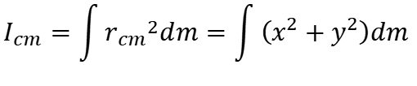

Parallel axis theorem: Introduction
$$I_{cm}=\int{{r_{cm}}^{2}dm}=\int{\left(x^{2}+y^{2}\right)dm}$$
$$I_{para}=\int{\left[{\left(x−a\right)}^{2}+{\left(y−b\right)}^{2}\right]dm}$$
Notes:
PARLER LENTEMENT: Here are the expression of both moment of inertia. We want to describe the moment of inertia around the axis parallel to the z-axis.

Slide 24
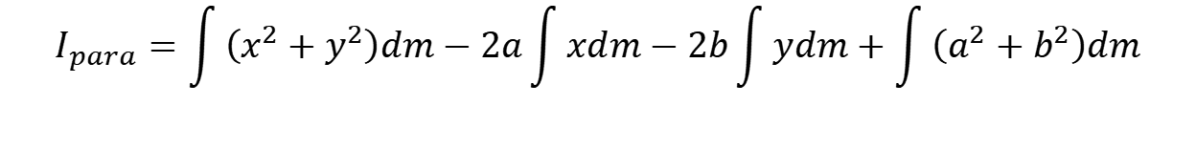

Parallel axis theorem: Introduction
$$I_{cm}=\int{{r_{cm}}^{2}dm}=\int{\left(x^{2}+y^{2}\right)dm}$$
$$I_{para}=\int{\left[{\left(x−a\right)}^{2}+{\left(y−b\right)}^{2}\right]dm}$$
$$I_{para}=\int{\left[x^{2}+y^{2}−2ax−2bx+a^{2}+b^{2}\right]dm}$$
$$I_{para}=\int{\left(x^{2}+y^{2}\right)dm}−2a\int{xdm}−2b\int{ydm}+\int{\left(a^{2}+b^{2}\right)dm}$$
Notes:
PARLER LENTEMENT: We obtain a sum of many integrals. This equation seems complicated but it can be simplified. You can see that the first term describes the moment of inertia for rotation around the z-axis.

Slide 25


Parallel axis theorem: Introduction
$$I_{cm}=\int{{r_{cm}}^{2}dm}=\int{\left(x^{2}+y^{2}\right)dm}$$
$$I_{para}=\int{\left[{\left(x−a\right)}^{2}+{\left(y−b\right)}^{2}\right]dm}$$
$$I_{para}=\int{\left[x^{2}+y^{2}−2ax−2bx+a^{2}+b^{2}\right]dm}$$
$$I_{para}=\int{\left(x^{2}+y^{2}\right)dm}−2a\int{xdm}−2b\int{ydm}+\int{\left(a^{2}+b^{2}\right)dm}$$
O is the center of mass:
$$\int{xdm}=0$$
$$\int{ydm}=0$$
Notes:
PARLER LENTEMENT: Also, the system of coordinates is chosen such as its origin O is also the center of mass of the body. This permits to have two terms of the equations which are equal zero.

Slide 26

Parallel axis theorem: Introduction
$$I_{cm}=\int{{r_{cm}}^{2}dm}=\int{\left(x^{2}+y^{2}\right)dm}$$
$$I_{para}=\int{\left[{\left(x−a\right)}^{2}+{\left(y−b\right)}^{2}\right]dm}$$
$$I_{para}=\int{\left[x^{2}+y^{2}−2ax−2bx+a^{2}+b^{2}\right]dm}$$
$$I_{para}=\int{\left(x^{2}+y^{2}\right)dm}−2a\int{xdm}−2b\int{ydm}+\int{\left(a^{2}+b^{2}\right)dm}$$
O is the center of mass:
$$\int{xdm}=0$$
$$\int{ydm}=0$$
$$I_{para}=I_{cm}+\int{d^{2}dm}$$
where $d=\sqrt{a^{2}+b^{2}}$ is the distance between both parallel axes.
Notes:
PARLER LENTEMENT: We obtain this expression, which can by simplified again. The distance between both parallel axes can be put outside the integral in the second term.

Slide 27
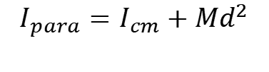
Parallel axis theorem: Introduction
$$I_{cm}=\int{{r_{cm}}^{2}dm}=\int{\left(x^{2}+y^{2}\right)dm}$$
$$I_{para}=\int{\left[{\left(x−a\right)}^{2}+{\left(y−b\right)}^{2}\right]dm}$$
$$I_{para}=\int{\left[x^{2}+y^{2}−2ax−2bx+a^{2}+b^{2}\right]dm}$$
$$I_{para}=\int{\left(x^{2}+y^{2}\right)dm}−2a\int{xdm}−2b\int{ydm}+\int{\left(a^{2}+b^{2}\right)dm}$$
O is the center of mass:
$$\int{xdm}=0$$
$$\int{ydm}=0$$
$$I_{para}=I_{cm}+\int{d^{2}dm}$$
$$I_{para}=I_{cm}+Md^{2}$$
where $d=\sqrt{a^{2}+b^{2}}$ is the distance between both parallel axes.
$\int{dm}=M$ is the total mass of the rigid body
Notes:
PARLER LENTEMENT: And finally we obtain this expression which is quite simple. M is the total mass of the body and d is the distance between both axis

Slide 28
Parallel axis theorem: Introduction
$$I_{cm}=\int{{r_{cm}}^{2}dm}=\int{\left(x^{2}+y^{2}\right)dm}$$
$$I_{para}=\int{\left[{\left(x−a\right)}^{2}+{\left(y−b\right)}^{2}\right]dm}$$
$$I_{para}=\int{\left[x^{2}+y^{2}−2ax−2bx+a^{2}+b^{2}\right]dm}$$
$$I_{para}=\int{\left(x^{2}+y^{2}\right)dm}−2a\int{xdm}−2b\int{ydm}+\int{\left(a^{2}+b^{2}\right)dm}$$
O is the center of mass:
$$\int{xdm}=0$$
$$\int{ydm}=0$$
$$I_{para}=I_{cm}+\int{d^{2}dm}$$
You don’t need to remember the demonstration but you must to remember this result.
$$I_{para}=I_{cm}+Md^{2}$$
where $d=\sqrt{a^{2}+b^{2}}$ is the distance between both parallel axes.
$\int{dm}=M$ is the total mass of the rigid body
Notes:
PARLER LENTEMENT:You don’t need to remember the demonstration but you must to remember this result, because with it could simplify a lot the determination of a moment of inertia.

Slide 29



Parallel axis theorem
$$d$$
Axis which pass through the center of mass of the body
An axis parallel to the first axis
$$C_{m}$$
$$+$$
The moment of inertia $I_{para}$ of a body of mass M for a rotation around an axis parallel to an axis which pass through the center of mass is:
$$I_{para}=I_{cm}+Md^{2}$$
Important to remember
where $I_{cm}$ is the moment of inertia for a rotation around the axis which pass through the center of mass of the body and $d$ the distance between both axes.
Notes:
PARLER LENTEMENT: This result we obtained are valid for bodies which are not thin-like. It is named the parallel axis theorem and permits to describe easily the moment of inertia for rotation around an axis which is parallel with an axis passing through the center of mass of the body, In the figure you see an example with a spherical body, To describe its moment of inertia passing through the parallel axis is easy if you know its moment of inertia for rotation around the axis passing through the center of mass of the sphere.

Slide 30
Parallel axis theorem
$$d$$
Axis which pass through the center of mass of the body
An axis parallel to the first axis
$$C_{m}$$
$$+$$
An interest of the parallel axis theorem: it is often much more easy to calculate the moment of inertia through the axis which pass through the center of mass !
Notes:
PARLER LENTEMENT: An interest of the parallel axis theorem: it is often much more easy to calculate the moment of inertia through the axis which pass through the center of mass !

Slide 31
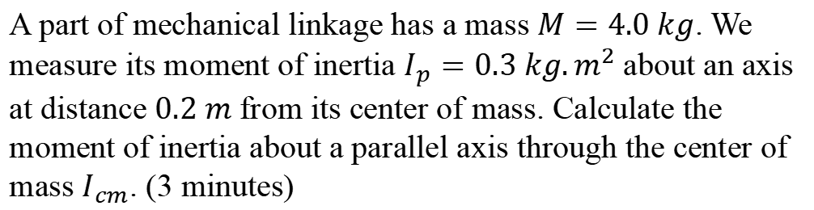
Ex. Using the parallel axis theorem
A part of mechanical linkage has a mass $M=4.0 kg$. We measure its moment of inertia $I_{p}=0.3 kg.m^{2}$about an axis at distance $0.2 m$ from its center of mass. Calculate the moment of inertia about a parallel axis through the center of mass $I_{cm}$. (3 minutes)
(no need a calculator for this one)
Notes:
PARLER LENTEMENT: Here is a little exercise. A part of mechanical linkage has a mass $M$. We measure its moment of inertia $I_{p}$about an axis at distance $0.2 m$ from its center of mass. Calculate the moment of inertia about a parallel axis through the center of mass $I_{cm}$.

Slide 32

Ex. Using the parallel axis theorem
A part of mechanical linkage has a mass $M=4.0 kg$. We measure its moment of inertia $I_{p}=0.3 kg.m^{2}$about an axis at distance $0.2 m$ from its center of mass. Calculate the moment of inertia about a parallel axis through the center of mass $I_{cm}$. (3 minutes)
Solution:
$$I_{para}=I_{cm}+Md^{2}$$
$$I_{cm}=I_{para}−Md^{2}$$
Notes:
PARLER LENTEMENT: From the parallel axis theorem, we can describe the moment of inertia about the axis passing through the center of mass.

Slide 33
Ex. Using the parallel axis theorem
A part of mechanical linkage has a mass $M=4.0 kg$. We measure its moment of inertia $I_{p}=0.3 kg.m^{2}$about an axis at distance $0.2 m$ from its center of mass. Calculate the moment of inertia about a parallel axis through the center of mass $I_{cm}$. (3 minutes)
Solution:
$$I_{para}=I_{cm}+Md^{2}$$
$$I_{cm}=I_{para}−Md^{2}$$
$$I_{cm}=0.3 kg.m^{2}−(4.0 kg){(0.2 m)}^{2}$$
Notes:
PARLER LENTEMENT: Then we have this simple calculation to do,

Slide 34

Ex. Using the parallel axis theorem
A part of mechanical linkage has a mass $M=4.0 kg$. We measure its moment of inertia $I_{p}=0.3 kg.m^{2}$about an axis at distance $0.2 m$ from its center of mass. Calculate the moment of inertia about a parallel axis through the center of mass $I_{cm}$. (3 minutes)
Solution:
$$I_{para}=I_{cm}+Md^{2}$$
$$I_{cm}=I_{para}−Md^{2}$$
$$I_{cm}=0.3 kg.m^{2}−(4.0 kg){(0.2 m)}^{2}$$
$$I_{cm}=0.14 kg.m^{2}$$
Notes:
PARLER LENTEMENT: And we obtain this result. In the exercise I said, no calculator is needed for this one, because it was quite easy to do without them.

Slide 35
3.Torque by a force
Notes:
PARLER LENTEMENT: Let’s to describe now the torque done by a force on a body.

Slide 36

Introduction
We have described how forces act on the translational motion of a body
$$\vec{F}=m\vec{a}$$
Net force on applied on a body
Acceleration vector of the center of mass of the body
Mass of the body
Notes:
PARLER LENTEMENT: We have described previously the net force exerted on a body acts on the translational motion on this body. The Newton second law permit to describe the translational motion of the center of mass of the body.

Slide 37
Introduction
We have described how forces act on the translational motion of a body
$$\vec{F}=m\vec{a}$$
Net force on applied on a body
Acceleration vector of the center of mass of the body
Mass of the body
But the Newton’s second law is not sufficient to describe the rotational motion of a body involved with the forces applied on it.
Notes:
PARLER LENTEMENT: But the Newton’s second law is not sufficient to describe the rotational motion of a body involved with the forces applied on it. If we want to describe also the rotational motion of a body we have to find another way about how the forces act on the rotational motion of a body.

Slide 38

Introduction
Questions:
Why the doorknob is at position 1 and not at position 2 ?
$$2$$
$$1$$
Notes:
PARLER LENTEMENT: And here is a door we want to close, or we want to open if the is closed. I show you two possible positions 1 and 2 where you could push the door. And here are few questions about the door. First, why the doorknob is at position 1 and not at the position 2. Did you already to try to puch the door at position 2 ? You can try at home and see the result.

Slide 39
Introduction
Questions:
Why the doorknob is at position 1 and not at position 2 ?
When you open a door, what is the direction of the force applied by your end and why ?
$$2$$
$$1$$
Notes:
PARLER LENTEMENT: Second question, when you open a door, what is the direction of the force applied by your end and why ? The direction of the force you apply on the door could be any direction, but every time you open a door, there is one direction you use.

Slide 40
Introduction
Questions:
Why the doorknob is at position 1 and not at position 2 ?
When you open a door, what is the direction of the force applied by your end and why ?
If there is no doorknob, what will be the point of application of the force done by the hand ?
$$2$$
$$1$$
Notes:
PARLER LENTEMENT: Third question. If there is no doorknob, what will be the point of application of the force done by the hand ?

Slide 41
Introduction
Questions:
Why the doorknob is at position 1 and not at position 2 ?
When you open a door, what is the direction of the force applied by your end and why ?
If there is no doorknob, what will be the point of application of the force done by the hand ?
$$2$$
$$1$$
Without to knowing it, you apply a maximum torque (for a given force strength of the your hand exerted on the door)
Notes:
PARLER LENTEMENT: Why I ask you these questions. ? This is because when open or close a door, you apply a maximum torque, for a given force strength of the your hand exerted on the door.

Slide 42



Introduction
The torque
is maximum far away the axis of rotation of the door.
$$\vec{r}$$
$$⨀$$
$$\vec{F}$$
$$\vec{r}$$
$$⨂$$
$$\vec{F}$$
$$\vec{r}$$
$$\vec{F}$$
Notes:
PARLER LENTEMENT: Let’s see what this little experiment says about the torque. The torque applied on a body on rotation is greater far away than close to the axis of rotation. This is the reason why the doorknob is far from the axis of rotation of the door.

Slide 43
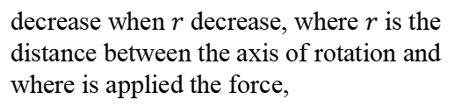
Introduction
The torque
is maximum far away the axis of rotation of the door.
decrease when $r$ decrease, where $r$ is the distance between the axis of rotation and where is applied the force,
$$\vec{r}$$
$$⨀$$
$$\vec{F}$$
$$\vec{r}$$
$$⨂$$
$$\vec{F}$$
$$\vec{r}$$
$$\vec{F}$$
Notes:
PARLER LENTEMENT: In the figure, the distance r is the distance from the axis of rotation. The torque descreases when the distance r decrease.

Slide 44

Introduction
The torque
is maximum far away the axis of rotation of the door.
decrease when $r$ decrease, where $r$ is the distance between the axis of rotation and where is applied the force,
$$\vec{r}$$
$$⨀$$
$$\vec{F}$$
$$\vec{r}$$
$$⨂$$
$$\vec{F}$$
is maximum if the force $\vec{F}$ exerted by the hand is perpendicular with door
$$\vec{r}$$
$$\vec{F}$$
Notes:
PARLER LENTEMENT: In the figure I show you 3 possible direction of the force exerted on the door. For the two first examples, the force exerted is perpendicular with vector r. For the third example the force F and the vector r have same directions. The torque is maximum if the force F perpendicular with door. You can try at home to rotate a door as in the third example, and you will see it is much more difficult. This is because the torque on the door will be zero, in the third example.

Slide 45

Introduction
The torque
is maximum far away the axis of rotation of the door.
decrease when $r$ decrease, where $r$ is the distance between the axis of rotation and where is applied the force,
$$\vec{r}$$
$$⨀$$
$$\vec{F}$$
$$\vec{r}$$
$$⨂$$
$$\vec{F}$$
is maximum if the force $\vec{F}$ exerted by the hand is perpendicular with door
$$\vec{r}$$
$$\vec{F}$$
equals zero if the force $\vec{F}$ exerted by the hand is directed on the plane of door.
Notes:
PARLER LENTEMENT: And the torque will be zero for any force directed in the plane of the door, as in the third example in the figure.

Slide 46

Introduction
The torque
is maximum far away the axis of rotation of the door.
decrease when $r$ decrease, where $r$ is the distance between the axis of rotation and where is applied the force,
$$\vec{r}$$
$$⨀$$
$$\vec{F}$$
$$\vec{r}$$
$$⨂$$
$$\vec{F}$$
is maximum if the force $\vec{F}$ exerted by the hand is perpendicular with door
$$\vec{r}$$
$$\vec{F}$$
equals zero if the force $\vec{F}$ exerted by the hand is directed on the plane of door.
depends to the magnitude of $\vec{F}$ (i.e. the force strength)
Notes:
PARLER LENTEMENT: Also if you push the door, you will see the door move plus or less easily depending to the strength of the force you apply on it. So, the torque depends to the magnitude of the force exerted.

Slide 47
Rest time (5 minutes)

Slide 48



The torque
$$\vec{F}$$
Force exerted on the body
O +
$$\vec{r}$$
$$+$$
$$P$$
A rigid body
Point of application of the force on the body (important to study the torque !)
Notes:
PARLER LENTEMENT: Now, let’s describe the torque by equation. Here we could consider a rigid body which rotates around the point O and the axis of rotation is perpendicular with the plane of the slide. But this is not an obligation and O can be any point in the body. A force is exerted on the rigid body at a certain point P which is named the point of application of the force. Take care that we want to study the rotational motion and the torque the point of application is important, because the torque exerted depends on it. As in the example with the door, the position of point P in respect with O is described by the position vector r.

Slide 49

The torque
$$\vec{F}$$
Force exerted on the body
O +
$$\vec{r}$$
$$+$$
$$P$$
A rigid body
Point of application of the force on the body (important to study the torque !)
The torque $\vec{τ}$ done by the force $\vec{F}$ about point O is:
$$\vec{τ}=\vec{r}×\vec{F}$$
important to remember
Notes:
PARLER LENTEMENT: The torque exerted by the force F about the point O is the vector product between the position vector r and the force exerted on the rigid body. This expression is important to remember.

Slide 50
The torque
$$\vec{F}$$
Force exerted on the body
O +
$$\vec{r}$$
$$+$$
$$P$$
A rigid body
Point of application of the force on the body (important to study the torque !)
The torque $\vec{τ}$ done by the force $\vec{F}$ about point O is:
$$\vec{τ}=\vec{r}×\vec{F}$$
important to remember
Warning: The torque is always defined about a point (the point O here)
Notes:
PARLER LENTEMENT: Take care also that I say “about point O” because a torque is always exerted about a point. This point O could be any point, in the body or outside the body. And this point could be in the axis of rotation or outside the axis of rotation. But usually, we will describe torques about a point in the axis of rotation.

Slide 51
The torque
$$\vec{F}$$
Force exerted on the body
O +
$$\vec{r}$$
$$+$$
$$P$$
A rigid body
Point of application of the force on the body (important to study the torque !)
The torque $\vec{τ}$ done by the force $\vec{F}$ about point O is:
$$\vec{τ}=\vec{r}×\vec{F}$$
important to remember
Warning: The torque is always defined about a point (the point O here)
The torque on a body about a point is the tendency of a force to cause rotation around this point.
Notes:
PARLER LENTEMENT: The torque on a body about a point describes the tendency of a force to cause rotation around this point.

Slide 52
The torque
$$\vec{τ}=\vec{r}×\vec{F}$$
The torque is a vector perpendicular to the plane defined by $\vec{r}$ and $\vec{F}$
Notes:
PARLER LENTEMENT: As you see, the torque is vector. This vector is perpendicular to the plane defined by the position vector r and the force F.

Slide 53
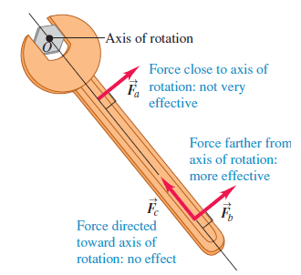

The torque
$$\vec{τ}=\vec{r}×\vec{F}$$
The torque is a vector perpendicular to the plane defined by $\vec{r}$ and $\vec{F}$
$${\vec{r}}_{a}$$
Notes:
PARLER LENTEMENT:. At the figure, you can different examples of forces exerted which apply or not a torque. For the force F_a, its direction about point O is perpendicular with the position vector r_a, but the point of application is close to the point O, which is also a point of the axis of rotation here. Thus, it will be not very efficient to rotate the tool by applying a force here. It is much more efficient to applied a force farther away from O which is the case of the force F_b. A third example of force is the force F_c. In this case, the torque exerted about O is zero, because the force is directed toward the axis of rotation. The force just pushes the tool, and there is no rotation. As I said before, the point O could be any point. For instance, it could be any point of the hexagonal piece or any point of the tool, but usually we will describe torque about a point O of the axis of rotation.

Slide 54




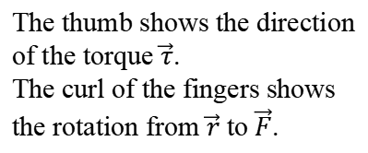

The torque
$$\vec{τ}=\vec{r}×\vec{F}$$
The torque is a vector perpendicular to the plane defined by $\vec{r}$ and $\vec{F}$
To find the direction of the torque, you can use a right-hand rule:
$$\vec{τ}$$
$$\vec{F}$$
The thumb shows the direction of the torque $\vec{τ}$.
The curl of the fingers shows the rotation from $\vec{r}$ to $\vec{F}$.
$$\vec{r}$$
$$⨀$$
The torque is directed along the axis of rotation
Notes:
PARLER LENTEMENT: To find the direction of the torque, you can use a right-hand rule. The curl of the fingers describes the rotation from position vector r to the force vector F. The thumb describes the direction of the torque. As you can see, the torque is directed along the axis of rotation.

Slide 55
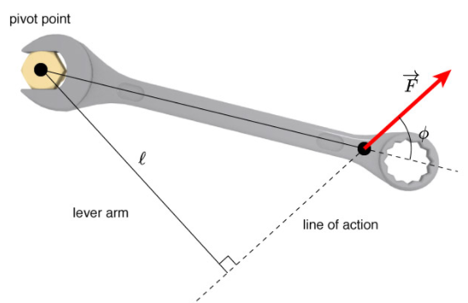

The torque
$$\vec{r}$$
$$\vec{τ}=\vec{r}×\vec{F}$$
Notes:
PARLER LENTEMENT: The point O in the axis of rotation in the plane defined by the position vector r and the force is named the pivot point. Along the direction of the force f is the line of action of the force. The distance l you see on the figure is named the lever arm. The torque depends also the lever arm. The angle phi here is the angle between the position vector r and the force exerted.

Slide 56

The torque
$$\vec{r}$$
$$\vec{τ}=\vec{r}×\vec{F}$$
$$τ=rF\sin{φ}$$
Notes:
PARLER LENTEMENT: The torque is the vector product between the position vector r and the force F, thus the magnitude of the distance r multiplied by the magnitude of the force and by the sines of the angle phi. A magnitude of a vector is always positive, but I don’t need to put in the equation the absolute value because the angle phi is always between zero and pi radians.

Slide 57

The torque
$$\vec{r}$$
$$\vec{τ}=\vec{r}×\vec{F}$$
$$τ=rF\sin{φ}$$
$$τ=lF$$
Notes:
PARLER LENTEMENT: From the figure, we deduce that the magnitude of the torque is the product between the distance l and the magnitude of the force.

Slide 58

The torque
$$\vec{r}$$
$$\vec{τ}=\vec{r}×\vec{F}$$
$$τ=rF\sin{φ}$$
$$τ=lF$$
$$l=r\sin{φ}$$
is the lever arm
Notes:
PARLER LENTEMENT: Where l is the lever arm exerted to rotate a rigid body about the pivot point.

Slide 59
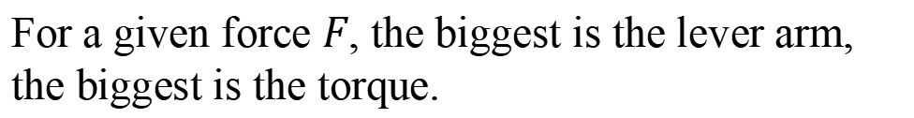
The torque
$$\vec{r}$$
$$\vec{τ}=\vec{r}×\vec{F}$$
$$τ=rF\sin{φ}$$
$$τ=lF$$
$$l=r\sin{φ}$$
is the lever arm
For a given force $F$, the biggest is the lever arm, the biggest is the torque.
Notes:
PARLER LENTEMENT: According the expression, for a given force F, the biggest is the lever arm, the biggest is the torque.

Slide 60
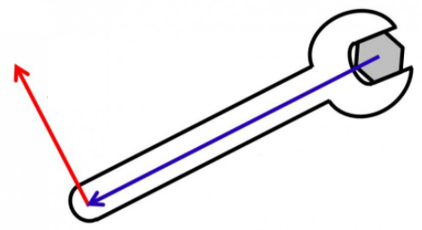



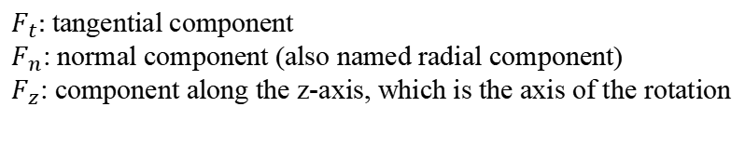





The torque
$$F_{t}\hat{t}$$
$$F_{n}\hat{n}$$
$$\vec{r}$$
$$⨀$$
$$F_{z}\hat{k}$$
$$⨀$$
$$z−axis$$
$F_{t}$: tangential component
$F_{n}$: normal component (also named radial component)
$F_{z}$: component along the z-axis, which is the axis of the rotation
$$\vec{F}=F_{t}\hat{t}+F_{n}\hat{n}+F_{z}\hat{k}$$
Notes:
PARLER LENTEMENT: We can describe a force as the sum of its components. For the situation we are studying, the force exerted can be described by three components. F_t, F_n, F_k. F_t is the tangential component of the force, tangent to the rotational motion described by the dashed curve. F_n is the radial component, we could shouse the unit vector n to be radially inward or radially outward, here. The axis of rotation is the the z-axis. And the unit vector along this axis of rotation is the vector k. Thus, there is also a component of the force exerted about this axis of rotation.

Slide 61
The torque
$$F_{t}\hat{t}$$
$$F_{n}\hat{n}$$
$$\vec{r}$$
$$⨀$$
$$F_{z}\hat{k}$$
$$⨀$$
$$z−axis$$
$F_{t}$: tangential component
$F_{n}$: normal component (also named radial component)
$F_{z}$: component along the z-axis, which is the axis of the rotation
$$\vec{F}=F_{t}\hat{t}+F_{n}\hat{n}+F_{z}\hat{k}$$
$$\vec{τ}=\vec{r}×\vec{F}=\vec{r}×F_{t}\hat{t}$$
Only the tangential component of the acting force is involved with its torque.
Notes:
PARLER LENTEMENT: And only the tangential component of the force as an effect on the torque. So, we could describe the torque as follows, as the vector product between the position vector r and the tangential force exerted. If the force is exerted on the plane defined by unit vector k and n, the tangential component of the force is zero, which means the torque about the axis of rotation is also zero.

Slide 62
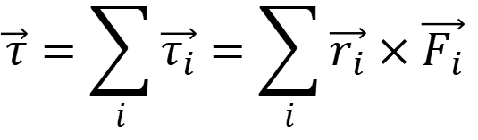







Net torque on a rigid body
rope
The net torque on a rigid body about a point O is the sum of all the torques acting on the body:
$$\vec{τ}=\sum_{i}{\vec{τ_{i}}}=\sum_{i}{\vec{r_{i}}×\vec{F_{i}}}$$
$${\vec{F}}_{1}$$
$$O$$
$${\vec{r}}_{1}$$
$${\vec{r}}_{2}$$
$${\vec{r}}_{3}$$
$${\vec{F}}_{3}$$
$${\vec{F}}_{2}$$
rope
Notes:
PARLER LENTEMENT: What about a situation where more than one force are exerted on a rigid body. In that case we have to describe a net torque exerted about a point. In the figure is an example of a rigid body where three forces are exerted on it, F_1, F_2 and F_3. The point of application about point O is different for all of these forces and described by position vector r_1, r_2, and r_3. The net torque exerted on a body about a point is simply the sum of all the torques about this point, as described in this equation.

Slide 63
Net torque on a rigid body
rope
The net torque on a rigid body about a point O is the sum of all the torques acting on the body:
$$\vec{τ}=\sum_{i}{\vec{τ_{i}}}=\sum_{i}{\vec{r_{i}}×\vec{F_{i}}}$$
$${\vec{F}}_{1}$$
$$O$$
$${\vec{r}}_{1}$$
$${\vec{r}}_{2}$$
The point O could be any point chosen, not only a point of the axis of rotation.
$${\vec{r}}_{3}$$
$${\vec{F}}_{3}$$
$${\vec{F}}_{2}$$
rope
Notes:
PARLER LENTEMENT: As previously, the point O could be any point chosen, not only a point of the axis of rotation, and could be outside or inside the rigid body.

Slide 64
Net torque on a rigid body
rope
The net torque on a rigid body about a point O is the sum of all the torques acting on the body:
$$\vec{τ}=\sum_{i}{\vec{τ_{i}}}=\sum_{i}{\vec{r_{i}}×\vec{F_{i}}}$$
$${\vec{F}}_{1}$$
$$O$$
$${\vec{r}}_{1}$$
$${\vec{r}}_{2}$$
The point O could be any point chosen, not only a point of the axis of rotation.
$${\vec{r}}_{3}$$
But we will mainly study torques about a point of the axis of rotation.
$${\vec{F}}_{3}$$
$${\vec{F}}_{2}$$
rope
Notes:
PARLER LENTEMENT: But we will mainly study torques about a point of the axis of rotation.

Slide 65




What about torques done by internal forces ?
Two parts of a body exert a force on each other (for instance gravitational force) and a corresponding torque about point O.
$$O$$
$$z−axis$$
$$⨀$$
$${\vec{r}}_{1}$$
$${\vec{r}}_{2}$$
$$1$$
$$l$$
$$2$$
$${\vec{F}}_{2/1}$$
$${\vec{F}}_{1/2}$$
Notes:
PARLER LENTEMENT: In the previous lesson, we have seen that there could internal forces and external forces exerted on a body but the net force is the sum of external forces exerted because the internal forces cancel to each other. What about the torque done by internal forces in a body? In the figure you can two part of a body which exert internal forces between them, it could be for instance a gravitational force, but it could be other kinds of forces we will see later. The force exerted by part 2 on 1 is F_2/1. The force exerted on part 1 on part 2 is F_1/2. The position vector of application of these internal forces are r_1 and r_2. We want to describe the torque about point O by these both internal forces.

Slide 66
What about torques done by internal forces ?
Two parts of a body exert a force on each other (for instance gravitational force) and a corresponding torque about point O.
$$O$$
$$z−axis$$
$$⨀$$
The internal forces between these two parts are along the same line
$${\vec{r}}_{1}$$
$${\vec{r}}_{2}$$
$$1$$
$$l$$
$$2$$
$${\vec{F}}_{2/1}$$
$${\vec{F}}_{1/2}$$
Notes:
PARLER LENTEMENT: You can see that the internal forces between these two parts are along the same line.

Slide 67

What about torques done by internal forces ?
Two parts of a body exert a force on each other (for instance gravitational force) and a corresponding torque about point O.
$$O$$
$$z−axis$$
$$⨀$$
The internal forces between these two parts are along the same line
$${\vec{r}}_{1}$$
$${\vec{r}}_{2}$$
$$1$$
$$l$$
$$2$$
The lever arm is the same for both forces
$${\vec{F}}_{2/1}$$
$${\vec{F}}_{1/2}$$
$$r_{1}\sin{φ_{1}=r_{2}\sin{φ_{2}}=l}$$
Notes:
PARLER LENTEMENT: And the lever arm is the same for both forces. It is the distance l shown on the figure.

Slide 68

What about torques done by internal forces ?
Two parts of a body exert a force on each other (for instance gravitational force) and a corresponding torque about point O.
$$O$$
$$z−axis$$
$$⨀$$
The internal forces between these two parts are along the same line
$${\vec{r}}_{1}$$
$${\vec{r}}_{2}$$
$$1$$
$$l$$
$$2$$
The lever arm is the same for both forces
$${\vec{F}}_{2/1}$$
$${\vec{F}}_{1/2}$$
$$r_{1}\sin{φ_{1}=r_{2}\sin{φ_{2}}=l}$$
The Newton third law:
$${\vec{F}}_{1/2}=−{\vec{F}}_{2/1}$$
Notes:
PARLER LENTEMENT: The Newton third law says that the internal forces have opposite direction and same magnitude, described by this equation.

Slide 69

What about torques done by internal forces ?
Two parts of a body exert a force on each other (for instance gravitational force) and a corresponding torque about point O.
$$O$$
$$z−axis$$
$$⨀$$
The internal forces between these two parts are along the same line
$${\vec{r}}_{1}$$
$${\vec{r}}_{2}$$
$$1$$
$$l$$
$$2$$
The lever arm is the same for both forces
$${\vec{F}}_{2/1}$$
$${\vec{F}}_{1/2}$$
$$r_{1}\sin{φ_{1}=r_{2}\sin{φ_{2}}=l}$$
The Newton third law:
$${\vec{F}}_{1/2}=−{\vec{F}}_{2/1}$$
$${\vec{τ}}_{1/2}=−{\vec{τ}}_{2/1}$$
Notes:
PARLER LENTEMENT: We obtain that the torque done by these internal forces have same direction and opposite magnitude. This is because the lever arm for both internal forces is the same and also because of the Newton third law.

Slide 70
What about torques done by internal forces ?
Two parts of a body exert a force on each other (for instance gravitational force) and a corresponding torque about point O.
$$O$$
$$z−axis$$
$$⨀$$
The internal forces between these two parts are along the same line
$${\vec{r}}_{1}$$
$${\vec{r}}_{2}$$
$$1$$
$$l$$
$$2$$
The lever arm is the same for both forces
$${\vec{F}}_{2/1}$$
$${\vec{F}}_{1/2}$$
$$r_{1}\sin{φ_{1}=r_{2}\sin{φ_{2}}=l}$$
The Newton third law:
$${\vec{F}}_{1/2}=−{\vec{F}}_{2/1}$$
$${\vec{τ}}_{1/2}=−{\vec{τ}}_{2/1}$$
Only the external forces contribute to the net torque on a rigid body
Notes:
PARLER LENTEMENT: Thus, only the external forces contribute to the net torque on a rigid body

Slide 71

What about torques done by internal forces ?
Two parts of a body exert a force on each other (for instance gravitational force) and a corresponding torque about point O.
$$O$$
$$z−axis$$
$$⨀$$
The internal forces between these two parts are along the same line
$${\vec{r}}_{1}$$
$${\vec{r}}_{2}$$
$$1$$
$$l$$
$$2$$
The lever arm is the same for both forces
$${\vec{F}}_{2/1}$$
$${\vec{F}}_{1/2}$$
$$r_{1}\sin{φ_{1}=r_{2}\sin{φ_{2}}=l}$$
The Newton third law:
$${\vec{F}}_{1/2}=−{\vec{F}}_{2/1}$$
$${\vec{τ}}_{1/2}=−{\vec{τ}}_{2/1}$$
Only the external forces contribute to the net torque on a rigid body
Net torque
$$\vec{τ}=\sum{{\vec{τ}}_{external forces}}$$
Notes:
PARLER LENTEMENT: In equation, we says the net torque exerted on a rigid body about a point is the sum of the torques of external forces exerted.

Slide 72
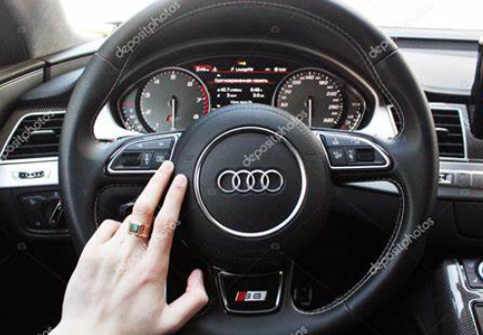

About the axis of rotation
We have seen the example of the door. This is particular case, because axis of rotation is fixed by the support of the door.
$$⨀$$
axis of rotation
Here is another example where the axis of rotation is fixed by the support. What if a body could rotates freely (i.e. without a support to fix the axis of rotation) ?
Notes:
PARLER LENTEMENT: Now, let’s describe more details about the axis of rotation. For the case of door or for the case of the wheel, the axis of rotation is not free. The support of the wheel or the support of the door let them to rotate around one axis of rotation. But what if a body could rotates freely ?

Slide 73
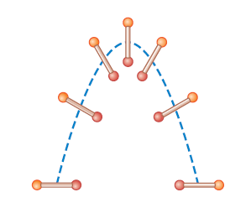
Center of mass and axis of rotation
If we throw a baton with applying a force to give him a rotation, its motion is as follows:
$$P$$
P is the center of mass of the baton.
$$P$$
$$P$$
$$P$$
$$P$$
$$P$$
$$P$$
The axis of rotation pass through the center of mass
Notes:
PARLER LENTEMENT: Here is an example. We throw a baton with applying a force and give him a rotation. As you can see on this figure. The baton rotate around its center of mass at point P here. The axis of rotation pass through the center of mass. About the direction of the axis of rotation, its depends on the forces which where exerted on the baton to rotate it. The direction of the axis of rotation correspond to maximum torque of the force used to rotate the rigid body.

Slide 74
About the axis of rotation
For this lecture, we consider only two kinds of rotation:
Rotation around an axis fixed by the support of the body studied
Notes:
PARLER LENTEMENT: In this lecture, we will study very simple cases of rotational motion, but you should know that rotational motion could be difficult to describe, Here are the cases we will study. First, we will study the rotation of a rigid body around an axis fixed by the support of the body studied.

Slide 75
About the axis of rotation
For this lecture, we consider only two kinds of rotation:
Rotation around an axis fixed by the support of the body studied
Rotation around an axis passing through the center of mass of the body
Notes:
PARLER LENTEMENT: And we will study the rotation around an axis passing through the center of mass of a body.

Slide 76
About the axis of rotation
For this lecture, we consider only two kinds of rotation:
Rotation around an axis fixed by the support of the body studied
Rotation around an axis passing through the center of mass of the body
There are situations of rotational motion more complicated (for instance, a body with two or three axis of rotation), but these situations will be not described during the lecture.
Notes:
PARLER LENTEMENT: However, there could be situation when a rigid body have rotational motion such as there are two or three axis of rotation. But these situation will be not described in this lecture.

Slide 77
4. The rotational analogy of Newton’s second law
Notes:
PARLER LENTEMENT: We have described what is torque. Now let’s describe the rotational motion of a rigid body from the torque exerted.

Slide 78





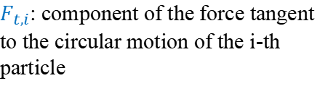
Introduction
$$z$$
$F_{t,i}$: component of the force tangent to the circular motion of the i-th particle
$$O_{i}$$
$${\vec{r}}_{i}$$
$$⨂$$
$$F_{t}\hat{t}$$
$$\vec{r}$$
$$y$$
$$⨂$$
$$x$$
$$O$$
Notes:
PARLER LENTEMENT: First, we consider a rigid body in rotation around the axis of rotation, here the Oz axis. And we divide this body in particles, where an arbitrary force is exerted on the i-th particle. This force could be tangent to the rotational motion, the circle in dashed curve you see here. But it could be have also any other direction and as previously we will describe the force exerted by its component. First is the tangential component of the force F_t.

Slide 79

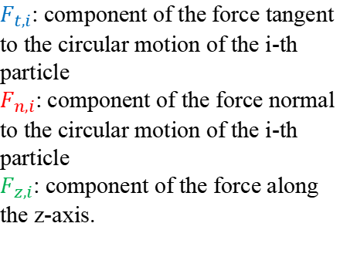

Introduction
$$z$$
$$F_{z}\hat{k}$$
$F_{t,i}$: component of the force tangent to the circular motion of the i-th particle
$F_{n,i}$: component of the force normal to the circular motion of the i-th particle
$F_{z,i}$: component of the force along the z-axis.
$$F_{n}\hat{n}$$
$$O_{i}$$
$${\vec{r}}_{i}$$
$$⨂$$
$$F_{t}\hat{t}$$
$$\vec{r}$$
$$y$$
$$⨂$$
$$x$$
$$O$$
Notes:
PARLER LENTEMENT: There is also a component of the force along the axis of rotation, I name it here F_z. And also there is a component perpendicular with the circular motion of the particle. I name it, F_n.

Slide 80
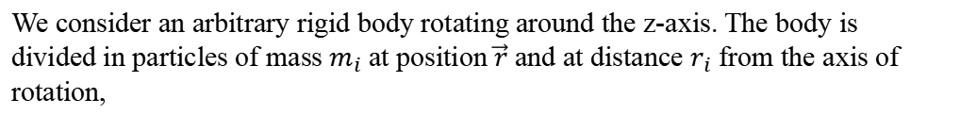
Introduction
$$z$$
$$F_{z}\hat{k}$$
$F_{t,i}$: component of the force tangent to the circular motion of the i-th particle
$F_{n,i}$: component of the force normal to the circular motion of the i-th particle
$F_{z,i}$: component of the force along the z-axis.
$$F_{n}\hat{n}$$
$$O_{i}$$
$${\vec{r}}_{i}$$
$$⨂$$
$$F_{t}\hat{t}$$
$$\vec{r}$$
$$y$$
$$⨂$$
$$x$$
$$O$$
We consider an arbitrary rigid body rotating around the z-axis. The body is divided in particles of mass $m_{i}$ at position $\vec{r}$ and at distance $r_{i}$ from the axis of rotation,
Notes:
PARLER LENTEMENT: The i-th particle is at distance r_i from the axis of rotation and has position vector r in respect with O the origin the coordinate system Oxyz. O is the also a point of the axis of rotation.

Slide 81
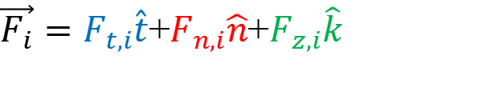
Introduction
$$z$$
$$F_{z}\hat{k}$$
$F_{t,i}$: component of the force tangent to the circular motion of the i-th particle
$F_{n,i}$: component of the force normal to the circular motion of the i-th particle
$F_{z,i}$: component of the force along the z-axis.
$$F_{n}\hat{n}$$
$$O_{i}$$
$${\vec{r}}_{i}$$
$$⨂$$
$$F_{t}\hat{t}$$
$$\vec{r}$$
$$y$$
$$⨂$$
$$x$$
$$O$$
We consider an arbitrary rigid body rotating around the z-axis. The body is divided in particles of mass $m_{i}$ at position $\vec{r}$ and at distance $r_{i}$ from the axis of rotation,
An arbitrary net force exerted on the i-th particle (which have a circular motion) is described as follows:
$\vec{F_{i}}=F_{t,i}\hat{t}$+$F_{n,i}\hat{n}$+$F_{z,i}\hat{k}$
Notes:
PARLER LENTEMENT: As described previously, an arbitrary force exerted on the i-th particle in the body is the sum of 3 vectors each vector corresponds to the components I have described you.

Slide 82
Introduction
$$z$$
$$F_{z}\hat{k}$$
$$F_{n}\hat{n}$$
$$O_{i}$$
$${\vec{r}}_{i}$$
$$⨂$$
$$F_{t}\hat{t}$$
$$\vec{r}$$
$$y$$
$$⨂$$
$$x$$
$$O$$
Only the tangential component $F_{t}$ affect the rotation because only $F_{t}\hat{t}$ exert a torque about O with a z-component (z-axis is the axis of rotation).
Notes:
PARLER LENTEMENT: And only the tangential component of the force affect the rotation because only the tangential component has an effect on the torque exerted by the force F about point O.

Slide 83

Introduction
$$z$$
$$F_{z}\hat{k}$$
$$F_{n}\hat{n}$$
$$O_{i}$$
$${\vec{r}}_{i}$$
$$⨂$$
$$F_{t}\hat{t}$$
$$\vec{r}$$
$$y$$
$$⨂$$
$$x$$
$$O$$
Newton’s second law for the tangential component of the force
Eq. 1
$$F_{t,i}=m_{i}a_{t,i}$$
Notes:
PARLER LENTEMENT: Now, let’s apply the Newton second law to this tangential component exerted on the i-th particle. The tangential component is the mass of the particle multiplied by the tangential acceleration.

Slide 84

Introduction
$$z$$
$$F_{z}\hat{k}$$
$$F_{n}\hat{n}$$
$$O_{i}$$
$${\vec{r}}_{i}$$
$$⨂$$
$$F_{t}\hat{t}$$
$$\vec{r}$$
$$y$$
$$⨂$$
$$x$$
$$O$$
Newton’s second law for the tangential component of the force
Eq. 1
$$F_{t,i}=m_{i}a_{t,i}$$
where $a_{t,i}$ is the tangential component of the acceleration related with the angular acceleration by:
$$a_{t,i}=r_{i}α$$
Eq. 2
Notes:
PARLER LENTEMENT: And this tangential acceleration is also the product between the distance from the axis of rotation and the angular acceleration we have described previously. From these equations we obtain a relation between the tangential component of the force and the angular acceleration.

Slide 85

Introduction
$$z$$
$$F_{z}\hat{k}$$
$$F_{n}\hat{n}$$
$$O_{i}$$
$${\vec{r}}_{i}$$
$$⨂$$
$$F_{t}\hat{t}$$
$$\vec{r}$$
$$y$$
$$⨂$$
$$x$$
$$O$$
Newton’s second law for the tangential component of the force
Eq. 1
$$F_{t,i}=m_{i}a_{t,i}$$
where $a_{t,i}$ is the tangential component of the acceleration related with the angular acceleration by:
$$a_{t,i}=r_{i}α$$
Eq. 2
Eq. 1 and Eq. 2
$$F_{t,i}=m_{i}r_{i}α$$
Notes:
PARLER LENTEMENT: It is that the tangential component is the product between the mass of the particle, the distance from the axis of rotation and the angular acceleration of the particle.

Slide 86

Introduction
$$z$$
$$F_{z}\hat{k}$$
$$F_{t,i}=m_{i}r_{i}α$$
$$×r_{i}$$
$$F_{n}\hat{n}$$
$$O_{i}$$
$${\vec{r}}_{i}$$
$$⨂$$
$$F_{t}\hat{t}$$
$$\vec{r}$$
$$y$$
$$⨂$$
$$x$$
$$O$$
Notes:
PARLER LENTEMENT: We can multiply both sides of the equation by the distance from the axis of rotation r_i.

Slide 87

Introduction
$$z$$
$$F_{z}\hat{k}$$
$$F_{t,i}=m_{i}r_{i}α$$
$$×r_{i}$$
$$F_{n}\hat{n}$$
$$O_{i}$$
$${\vec{r}}_{i}$$
$$⨂$$
$$r_{i}F_{t,i}=m_{i}r_{i}^{2}α$$
$$F_{t}\hat{t}$$
$$\vec{r}$$
$$y$$
$$⨂$$
$$x$$
$$O$$
Notes:
PARLER LENTEMENT: We obtain the following result.

Slide 88


Introduction
$$z$$
$$F_{z}\hat{k}$$
$$F_{t,i}=m_{i}r_{i}α$$
$$×r_{i}$$
$$F_{n}\hat{n}$$
$$O_{i}$$
$${\vec{r}}_{i}$$
$$⨂$$
$$r_{i}F_{t,i}=m_{i}r_{i}^{2}α$$
$$F_{t}\hat{t}$$
$$τ_{i}=m_{i}r_{i}^{2}α$$
$$\vec{r}$$
$τ_{i}$:torque exerted on the i-th particle
$$y$$
$$⨂$$
$$x$$
$$O$$
Notes:
PARLER LENTEMENT: And this result is also the magnitude of the torque exerted on the on the i-th particle by the force F about point O_i. After few mathematics, we could also demonstrate it is also the torque about the point O, and it is the torque about any point of the axis of rotation Oz. Thus, instead to describe a torque about a point, we could also describe a torque about an axis of rotation.

Slide 89

Introduction
$$z$$
$$F_{z}\hat{k}$$
$$F_{t,i}=m_{i}r_{i}α$$
$$×r_{i}$$
$$F_{n}\hat{n}$$
$$O_{i}$$
$${\vec{r}}_{i}$$
$$⨂$$
$$r_{i}F_{t,i}=m_{i}r_{i}^{2}α$$
$$F_{t}\hat{t}$$
$$τ_{i}=m_{i}r_{i}^{2}α$$
$$\vec{r}$$
$τ_{i}$:torque exerted on the i-th particle
$$y$$
$$⨂$$
$$x$$
$$O$$
$$τ=\sum_{i}{τ_{i}}=\left(\sum_{i}{m_{i}r_{i}^{2}}\right)α$$
The net torque about the axis of the rotation exerted on the whole system of particles is:
Moment of inertia about the z-axis.
Notes:
PARLER LENTEMENT: And the net torque about the axis of rotation is the sum of all the torque exerted by the force F on the particles. We obtain the following expression where appears the angular acceleration and the moment of inertia about the axis of rotation.

Slide 90

“Rotational” Newton’s second law
The net torque exerted on a body in rotation around an axis, about an axis of rotation (or a point of the axis of rotation), is:
$$\vec{τ}=I\vec{α}$$
Important to remember
Moment of inertia (about this axis)
Angular acceleration
Notes:
PARLER LENTEMENT: We deduce the rotational analogy of the Newton’s second law. You can see that this relation is similar with the Newton second. The net torque exerted on a rigid body about an axis of rotation or about a point of the axis of rotation is the product between the moment of inertia of the body about the axis of rotation and the angular acceleration vector which describe the rotational motion of the body around the axis of rotation. You don’t need to remember the demonstration, but you have to remember this result.

Slide 91

“Rotational” Newton’s second law
The net torque exerted on a body in rotation around an axis, about an axis of rotation (or a point of the axis of rotation), is:
$$\vec{τ}=I\vec{α}$$
Important to remember
Moment of inertia (about this axis)
Angular acceleration
z-component (with z-axis the axis of rotation):
$$τ_{z}=Iα_{z}$$
Notes:
PARLER LENTEMENT: And we have describe the z-component of the angular acceleration vector, where the z-axis was the axis of rotation. So, here is the component of the torque along the axis of rotation,

Slide 92
Rest time (5 minutes)

Slide 93
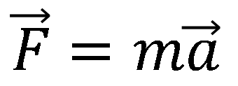
“Rotational” Newton’s second law
The net torque exerted on a body in rotation around an axis, about a point of this axis, is:
$$\vec{τ}=I\vec{α}$$
Important to remember
Moment of inertia (about this axis)
Angular acceleration
We can see the analogy with the Newton’s second law:
$$\vec{F}=m\vec{a}$$
Net force
“linear” acceleration
mass
Notes:
PARLER LENTEMENT: You can see here the analogy with the Newton second law, instead to have a mass in the equation, we have the moment of inerta I. Take care that the moment of inertia depends to the axis we consider, and here it should be about the axis of rotational motion.

Slide 94
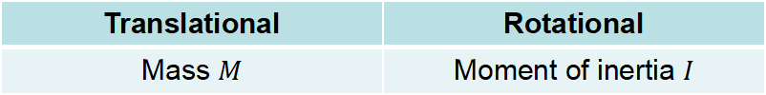
Analogy between translational and rotational motion of a body
Translational | Rotational
Mass $M$ | Moment of inertia $I$
Notes:
PARLER LENTEMENT: Now I will summary the analogies between the translational and the rotational motion. The equivalent of the mass for the rotational motion is the moment of inertia of the body about the axis of rotation.

Slide 95
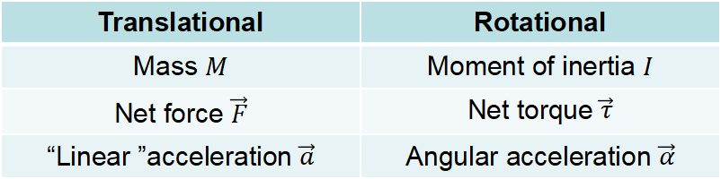
Analogy between translational and rotational motion of a body
Translational | Rotational
Mass $M$ | Moment of inertia $I$
Net force $\vec{F}$ | Net torque $\vec{τ}$
“Linear ”acceleration $\vec{a}$ | Angular acceleration $\vec{α}$
Notes:
PARLER LENTEMENT: The equivalent of the net force exerted is the net torque exerted about the axis of rotational motion. The equivalent of the acceleration vector is the angular acceleration vector.

Slide 96
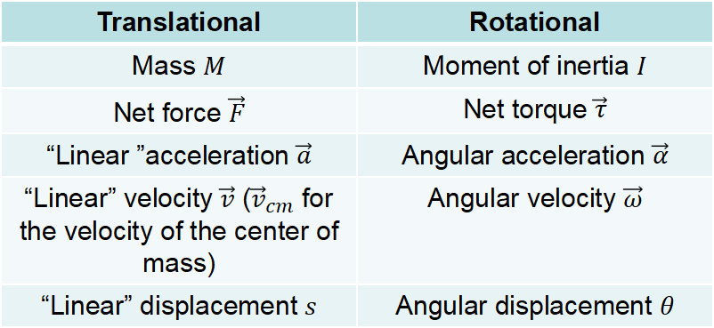
Analogy between translational and rotational motion of a body
Translational | Rotational
Mass $M$ | Moment of inertia $I$
Net force $\vec{F}$ | Net torque $\vec{τ}$
“Linear ”acceleration $\vec{a}$ | Angular acceleration $\vec{α}$
“Linear” velocity $\vec{v}$ (${\vec{v}}_{cm}$ for the velocity of the center of mass) | Angular velocity $\vec{ω}$
“Linear” displacement $s$ | Angular displacement $θ$
Notes:
PARLER LENTEMENT: And as there is a linear displacement and velocity (I write “linear” to say “it is not angular” ), there is angular displacement and an angular velocity.

Slide 97
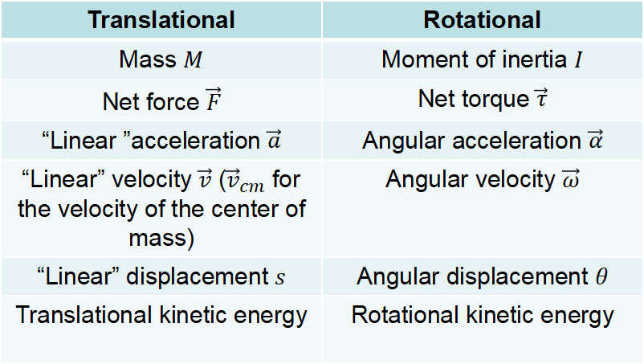
Analogy between translational and rotational motion of a body
Translational | Rotational
Mass $M$ | Moment of inertia $I$
Net force $\vec{F}$ | Net torque $\vec{τ}$
“Linear ”acceleration $\vec{a}$ | Angular acceleration $\vec{α}$
“Linear” velocity $\vec{v}$ (${\vec{v}}_{cm}$ for the velocity of the center of mass) | Angular velocity $\vec{ω}$
“Linear” displacement $s$ | Angular displacement $θ$
Translational kinetic energy | Rotational kinetic energy
Notes:
PARLER LENTEMENT: And as a body has translational kinetic energy, it has also a rotational kinetic energy.

Slide 98
Analogy between translational and rotational motion of a body
Translational | Rotational
Mass $M$ | Moment of inertia $I$
Net force $\vec{F}$ | Net torque $\vec{τ}$
“Linear ”acceleration $\vec{a}$ | Angular acceleration $\vec{α}$
“Linear” velocity $\vec{v}$ (${\vec{v}}_{cm}$ for the velocity of the center of mass) | Angular velocity $\vec{ω}$
“Linear” displacement $s$ | Angular displacement $θ$
Translational kinetic energy | Rotational kinetic energy
Questions: A rigid body has a translational and rotational motion (around an axis passing through its center of mass). Please to describe (2 minutes):
its translational kinetic energy
its rotational kinetic energy
its total kinetic energy (translational + rotational kinetic energy)
Notes:
PARLER LENTEMENT: Considering a body as translational and a rotational motion, please to describe it from what is written on the table its translational kinetic energy, its rotational kinetic energy and its total kinetic energy.

Slide 99

Kinetic energy of a body with translational and rotational motion
Translational kinetic energy:
$$\frac{1}{2}Mv_{cm}^{2}$$
Notes:
PARLER LENTEMENT: First, the translational kinetic energy is the half of its mass multiplied by the square of the velocity of its center of mass.

Slide 100


Kinetic energy of a body with translational and rotational motion
Translational kinetic energy:
$$\frac{1}{2}Mv_{cm}^{2}$$
$$\frac{1}{2}Iω^{2}$$
Rotational kinetic energy:
$M$: mass of the body, $v_{cm}$: velocity of the center of mass
$I$: Moment of inertia about the axis of rotation.
Notes:
PARLER LENTEMENT: Its rotational kinetic energy has a similar expression. It is the half of the moment of inertia about the axis of rotation multiplied by the square of the angular velocity.

Slide 101

Kinetic energy of a body with translational and rotational motion
Translational kinetic energy:
$$\frac{1}{2}Mv_{cm}^{2}$$
$$\frac{1}{2}Iω^{2}$$
Rotational kinetic energy:
$M$: mass of the body, $v_{cm}$: velocity of the center of mass
$I$: Moment of inertia about the axis of rotation.
$$E_{k}=\frac{1}{2}Mv_{cm}^{2}+\frac{1}{2}Iω^{2}$$
Total kinetic energy:
Important to remember
Notes:
PARLER LENTEMENT:

Slide 102
Kinetic energy of a body with translational and rotational motion
Translational kinetic energy:
$$\frac{1}{2}Mv_{cm}^{2}$$
$$\frac{1}{2}Iω^{2}$$
Rotational kinetic energy:
$M$: mass of the body, $v_{cm}$: velocity of the center of mass
$I$: Moment of inertia about the axis of rotation.
$$E_{k}=\frac{1}{2}Mv_{cm}^{2}+\frac{1}{2}Iω^{2}$$
Total kinetic energy:
Important to remember
Notes:
PARLER LENTEMENT: Then we deduce the total kinetic energy which is the sum of both kinds of kinetic energy. Please to remember this expression.

Slide 103

Kinetic energy of a body with translational and rotational motion
Translational kinetic energy:
$$\frac{1}{2}Mv_{cm}^{2}$$
$$\frac{1}{2}Iω^{2}$$
Rotational kinetic energy:
$M$: mass of the body, $v_{cm}$: velocity of the center of mass
$I$: Moment of inertia about the axis of rotation.
$$E_{k}=\frac{1}{2}Mv_{cm}^{2}+\frac{1}{2}Iω^{2}$$
Total kinetic energy:
Important to remember
For a system of bodies of kinetic energy $E_{k,i}$ , mass $M_{i}$, velocity of center of mass $v_{cm,i}$, moment of inertia about their axis of rotation $I_{i}$, angular velocity $ω_{i}$:
$$E_{k}=\sum_{i}{E_{k,i}}=\sum_{i}{\left(\frac{1}{2}M_{i}v_{cm,i}^{2}+\frac{1}{2}I_{i}{ω_{i}}^{2}\right)}$$
Notes:
PARLER LENTEMENT: We could also describe the total kinetic energy of a system of bodies, as we did about the total kinetic energy involved with collisions between bodies. In that case the total kinetic energy of the system is the sum of all the kinetic energy of the bodies in the system and his sum between all the translational kinetic energy and all the rotational kinetic energy.

Slide 104

Kinetic energy of a body with translational and rotational motion
Translational kinetic energy:
$$\frac{1}{2}Mv_{cm}^{2}$$
$$\frac{1}{2}Iω^{2}$$
Rotational kinetic energy:
$M$: mass of the body, $v_{cm}$: velocity of the center of mass
$I$: Moment of inertia about the axis of rotation.
$$E_{k}=\frac{1}{2}Mv_{cm}^{2}+\frac{1}{2}Iω^{2}$$
Total kinetic energy:
Important to remember
If the body has only translational motion (no rotation: $ω=0$)
$$E_{k}=\frac{1}{2}Mv_{cm}^{2}$$
Notes:
PARLER LENTEMENT: And we can see two kinds of particular cases. In the case of a body which has no rotational motion, its angular velocity is zero. In that case, the kinetic energy of the body is its translational kinetic energy,

Slide 105


Kinetic energy of a body with translational and rotational motion
Translational kinetic energy:
$$\frac{1}{2}Mv_{cm}^{2}$$
$$\frac{1}{2}Iω^{2}$$
Rotational kinetic energy:
$M$: mass of the body, $v_{cm}$: velocity of the center of mass
$I$: Moment of inertia about the axis of rotation.
$$E_{k}=\frac{1}{2}Mv_{cm}^{2}+\frac{1}{2}Iω^{2}$$
Total kinetic energy:
Important to remember
If the body has only translational motion (no rotation: $ω=0$)
$$E_{k}=\frac{1}{2}Mv_{cm}^{2}$$
If the body has only rotational motion (velocity of the center of mass $v_{cm}=0$)
$$E_{k}=\frac{1}{2}Iω^{2}$$
Notes:
PARLER LENTEMENT: In the case of the body has no translational motion, which means the velocity of its center of mass is zero, the kinetic energy of the body is its rotational kinetic energy.

Slide 106


Ex: Rolling without slipping
$$v_{cm}$$
motion
A wheel rolls without slipping. It has a translational and rotational motion. The contact point with the ground is instantaneously at rest, i.e. $v=0$ (the wheel don’t slip).
Notes:
PARLER LENTEMENT: Now let’s see the particular case of a wheel which have a rolling without sleeping. The wheel moves toward the right and has both translational motion and rotational motion. An any time there is a point of contact between the wheel and the ground. And the velocity of the this point of contact is zero because the wheel has no slipping.

Slide 107


Ex: Rolling without slipping
$$v_{cm}$$
motion
A wheel rolls without slipping. It has a translational and rotational motion. The contact point with the ground is instantaneously at rest, i.e. $v=0$ (the wheel don’t slip).
$$\vec{v_{cm}}$$
$$\vec{v_{cm}}$$
$$\vec{v_{cm}}$$
$$+$$
$$\vec{v_{cm}}$$
translational motion
$$−\vec{v_{cm}}$$
rotational motion
Notes:
PARLER LENTEMENT: We can describe the motion of the wheel of the sum of two motions, one his the translational motion at the left which is the motion with velocity v_cm, the velocity of the center of mass. It is the same translational motion described by the same velocity vector for all the points of the wheel. And at the right, is the rotational motion of all the point of wheel with velocity which is the velocity vector of the center of mass at the top of the wheel. This is why at the top of the wheel the velocity vector is bigger than the velocity vector of the center of mass. An the down of the wheel, the velocity vector for the point of contact between the wheel has opposite direction and same magnitude that the velocity vector of the center of mass. Still about the rotational motion, between the top and the down of the wheel, the velocity vector of points of the wheel, the velocity vector has same magnitude than the velocity vector of the center of mass and the direction of the velocity vector depends to the angular position of the point on the wheel.

Slide 108



Ex: Rolling without slipping
$$?$$
$$v_{cm}$$
Translational motion at constant velocity $\vec{v_{cm}}$
A wheel rolls without slipping. It has a translational and rotational motion. The contact point with the ground is instantaneously at rest, i.e. $v=0$ (the wheel don’t slip).
Please to describe (5 minutes):
The velocity vector of the point at the top point of the wheel in respect with the velocity of the center of mass $\vec{v_{cm}}$
Notes:
PARLER LENTEMENT: So, here is a little exercise. First please to describe what is the velocity vector at the top of the wheel considering both translational and rotational motion of the wheel.

Slide 109

Ex: Rolling without slipping
$$?$$
$$v_{cm}$$
Translational motion at constant velocity $\vec{v_{cm}}$
A wheel rolls without slipping. It has a translational and rotational motion. The contact point with the ground is instantaneously at rest, i.e. $v=0$ (the wheel don’t slip).
Please to describe (5 minutes):
The velocity vector of the point at the top point of the wheel in respect with the velocity of the center of mass $\vec{v_{cm}}$
The velocity of the center of mass of the wheel $v_{cm}$ in respect with its radius $R$ and angular velocity $ω$
Notes:
PARLER LENTEMENT: Then, please to describe the velocity of center of mass of the whell in respect with the radisu of the wheel and the angular velocity.

Slide 110

Ex: Rolling without slipping
$$?$$
$$v_{cm}$$
Translational motion at constant velocity $\vec{v_{cm}}$
A wheel rolls without slipping. It has a translational and rotational motion. The contact point with the ground is instantaneously at rest, i.e. $v=0$ (the wheel don’t slip).
Please to describe (5 minutes):
The velocity vector of the point at the top point of the wheel in respect with the velocity of the center of mass $\vec{v_{cm}}$
The velocity of the center of mass of the wheel $v_{cm}$ in respect with its radius $R$ and angular velocity $ω$
Its total kinetic energy (translational + rotational) in respect to its mass $M$, moment of inertia $I_{cm}$(rotation around axis of passing through center of mass) and angular velocity $ω$.
Notes:
PARLER LENTEMENT: And finnaly please to describe the total kinetic energy of the wheel in respect with its mass, its moment of inertia about the axis of rotation passing through the center of mass, and the angular velocity of the wheel.

Slide 111

Ex: Rolling without slipping
Top of the wheel
$$\vec{v_{cm}}$$
$$\vec{v_{cm}}$$
$$\vec{v_{cm}}$$
$$+$$
$$\vec{v_{cm}}$$
translational motion
$$−\vec{v_{cm}}$$
rotational motion
Because the translational and rotational motion the velocity at the top of the wheel is:
$$\vec{v}=2\vec{v_{cm}}$$
Notes:
PARLER LENTEMENT: First, we have to consider both translational and rotational motion. At the top of the wheel for the translational motion, the velocity vector is the velocity vector of the center of mass. About the rotational motion, the velocity vector is also the velocity of the center of mass. Thus, the velocitu vector at the top of the wheel is twice the velocity vector of the center of mass.

Slide 112

Ex: Rolling without slipping
$$R$$
$$2πR$$
One point of the perimeter have done one cycle (of period $T$) when the wheel has travel the distance $2πR$. The velocity of the center of mass is such as:
Notes:
PARLER LENTEMENT: Now, let’s describe the velocity vector. There is not only one possible demonstration. We consider a point of the wheel which describe a full circle, as in the figure, during a certain time T which is also named the period of the cycle. During this time, the wheel travels a distance of 2pi multipled by the radius of the wheel, this distance is also the circumference of the wheel,

Slide 113

Ex: Rolling without slipping
$$R$$
$$2πR$$
One point of the perimeter have done one cycle (of period $T$) when the wheel has travel the distance $2πR$. The velocity of the center of mass is such as:
$$v_{cm}=\frac{2πR}{T}$$
Notes:
PARLER LENTEMENT: We obtain a description of the velocity of the center of mass, it is the circumference of the wheel described by the time the wheel travels during one cycle.

Slide 114

Ex: Rolling without slipping
$$R$$
$$2πR$$
One point of the perimeter have done one cycle (of period $T$) when the wheel has travel the distance $2πR$. The velocity of the center of mass is such as:
$$v_{cm}=\frac{2πR}{T}$$
The angular velocity is
$$ω=\frac{2π}{T}$$
Notes:
PARLER LENTEMENT: And the angular velocity of the wheel can be expressed as follows, it is the 2 pi divided by the period of one cycle T. Here is an example where the angular velocity of the rotational motion is constant, so the instantaneous angular velocity is also the average angular velocity. The angular displacement of 2pi on the point shown on the figure corresponds to the period T.

Slide 115

Ex: Rolling without slipping
$$R$$
$$2πR$$
One point of the perimeter have done one cycle (of period $T$) when the wheel has travel the distance $2πR$. The velocity of the center of mass is such as:
$$v_{cm}=\frac{2πR}{T}$$
$$v_{cm}=Rω$$
The angular velocity is
$$ω=\frac{2π}{T}$$
A condition for rolling without slipping (this relation is wrong if the wheel is slipping ! )
Notes:
PARLER LENTEMENT: From these two equation we obtain that the velocity of the center of mass is the product between the radius of the circular motion and the angular velocity. This equation is valid only because we have considered the case of rolling without slippling. It is named “a condition of the rolling without slipping” and if there is slipping, we cannot use it.

Slide 116

Ex: Rolling without slipping
Total kinetic energy of the wheel:
$$E_{k}=\frac{1}{2}Mv_{cm}^{2}+\frac{1}{2}I_{cm}ω^{2}$$
Notes:
PARLER LENTEMENT: Now, let’s describe the total kinetic energy of the wheel. It is the sum of its translational and rotational kinetic energy.

Slide 117

Ex: Rolling without slipping
Total kinetic energy of the wheel:
$$E_{k}=\frac{1}{2}Mv_{cm}^{2}+\frac{1}{2}I_{cm}ω^{2}$$
$$E_{k}=\frac{1}{2}M{\left(Rω\right)}^{2}+\frac{1}{2}I_{cm}ω^{2}$$
Notes:
PARLER LENTEMENT: In the equation, we put the expression of the velocity of the center of mass we have found previously.

Slide 118

Ex: Rolling without slipping
Total kinetic energy of the wheel:
$$E_{k}=\frac{1}{2}Mv_{cm}^{2}+\frac{1}{2}I_{cm}ω^{2}$$
$$E_{k}=\frac{1}{2}M{\left(Rω\right)}^{2}+\frac{1}{2}I_{cm}ω^{2}$$
$$E_{k}=\frac{1}{2}MR^{2}ω^{2}+\frac{1}{2}I_{cm}ω^{2}=\frac{1}{2}\left(I_{cm}+MR^{2}\right)ω^{2}$$
Notes:
PARLER LENTEMENT: We obtain the following expression, which is great if you find it. But you can see also particular in this equation.

Slide 119

Ex: Rolling without slipping
Total kinetic energy of the wheel:
$$E_{k}=\frac{1}{2}Mv_{cm}^{2}+\frac{1}{2}I_{cm}ω^{2}$$
$$E_{k}=\frac{1}{2}M{\left(Rω\right)}^{2}+\frac{1}{2}I_{cm}ω^{2}$$
$$E_{k}=\frac{1}{2}MR^{2}ω^{2}+\frac{1}{2}I_{cm}ω^{2}=\frac{1}{2}\left(I_{cm}+MR^{2}\right)ω^{2}$$
$$I_{1}$$
$I_{1}$ is the moment of inertia of the wheel for a rotation around an axis at distance $R$ from the center of mass (also perpendicular to the wheel) !
Notes:
PARLER LENTEMENT: By applying the parallel axis theorem, you can see that the total kinetic energy is also the half of the moment of inertia about an axis parallel to the axis of rotation and at distance R from this axis of rotation. As if the wheel has only one rotational motion about this parallel axis,

Slide 120
End of the lecture

